Slide 1
CARGO LOGISTICS AND LIABILITY IN A MULTIMODAL ENVIRONNMENT
REX on a recent French cargo case:
Access to data is key, but does not open all doors…
by
Sigrid Preissl, Avocate à la Cour

Slide 2
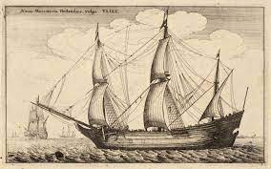
The changing nature of cargo lostistics – full spead ahead or back to the roots?
1897
1720
1770

Slide 3
Paris Court of Appeals, April 4th 2022

Slide 4
Facts in a nutshell
French buyer bought three sets of hard drives from chinese manufacturer
Goods insured by UK based cargo insurer.
French buyer entrusted a multimodal freight forwarder, with the organization of the transport of the products by air and then by road from China to its operating premises in Massy (outside Paris).
Affiliated company of freight forwarder acted as a substitute freight forwarder to organize road carriage between Roissy CDG airport and Massy.

Slide 5
Road carrier was retained by substitute freight forwarder
19 July 2012: Road carrier picked up seven pallets for transport to the premises of French buyer
25 July 2012: Buyer notified by letter to multimodal freight forwarder that three pallets were missing (worth USD 252,000).
26 July 2012: Buyer registers a complaint for theft with police
Cargo insurer compensates French buyer for 252.000 USD (value of stolen cargo)
Cargo insurer introduces proceedings before French courts following subrogation in 2012

Slide 6
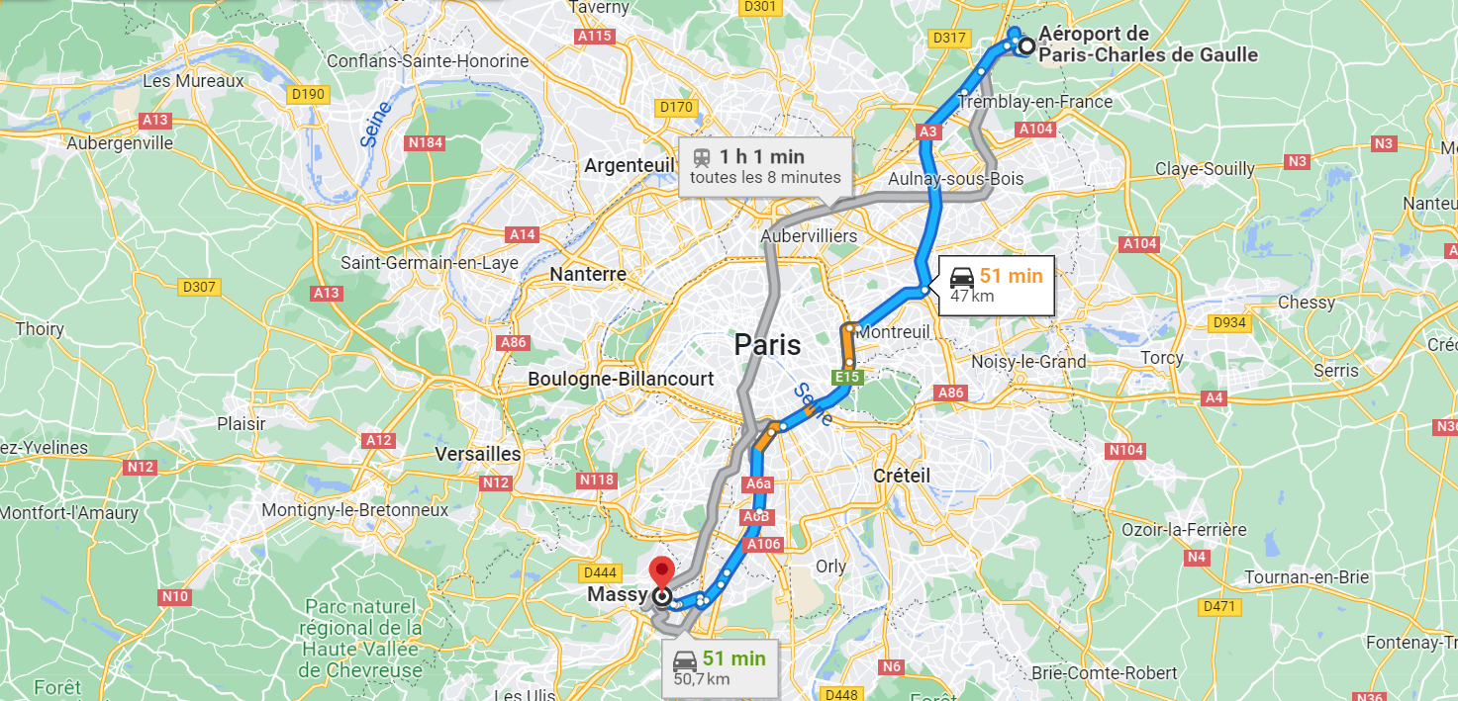

Slide 7
Proceedings France 2012 – 2022
Incident July 2012
Search warrant June 2014
Decision criminal court (driver) September 2015
Jugement Commercial Court Bobigny December 2018
Decision Court of Appeals Paris April 2022
10 years of court proceedings

Slide 8
Article L 133-3 French Code of Commerce (road carriage): one of the most dangerous French pitfalls
“Upon acceptance of the goods carried, any action against the carrier for damage or partial loss shall be extinguished unless the consignee, within three days, not counting holidays, after delivery, has notified the carrier of his reasoned protest by extrajudicial service by bailiff or by registered letter. All provisions to the contrary shall be null and void. The latter provision shall not apply to international carriage".

Slide 9
Best of pitfalls of French transportation law (I):
Intra-French transport of goods by road – public order
Partial loss or damage (also in case of total loss - but not applicable if never delivered or delayed)
Motivated letter of protest (detailed description of damage)
By registered regular mail (express courier tolerated), email/fax not sufficient even with acknowledgement of receipt (Court of Appeals of VERSAILLES, 2.7.2013, n°11/05748)

Slide 10
Best of pitfalls of French transportation law (II):
To be sent by consignee (text), but case law allows protest letter from shipper or freight forwarder.
Applies even if damage was hidden/not obvious/delayed (Supreme Court, Nov. 7, 2006).
Dispatch within 3 days (except Sunday and holidays).
Exceptions: Clear acknowledgement of protest by carrier at delivery (on waybill). Dol of the carrier (falsification of delivery bill, deliberate misrepresentation of damage). “Gross negligence" not sufficient

Slide 11
Decision Court of Appels of Paris - April 7th 2022
RG 19/02142
Application French law (carriage of goods by road)
Article L 133-3 Commercial Code
Letter of protest sent on July 25th 2012 beyond delay of 3 days following delivery (July 19th 2012)
No proof of malicous acts having prevented French Buyer to be viligent, check complete receipt and send letter of protest within 3 days
Dismissal of cargo insurers’ claim against all parties.

Slide 12
Lessons learnt ?
Multimodal approach vs unimodal focus
Pitfalls of local legislation
Access to data is key, but cannot override mandatory legal constraints
Technical infrastructure vs legal instrastructure
full spead ahead or back to the roots ?

Slide 13
ENJOY YOUR STAY IN PARIS !
Clément ADER
« AVION 3 », 1893-1897
From « avis » (latin) meaning bird
Musée arts et métiers, Paris
Prototype offered by Clément Ader to France in 1903

